Slide 1

Aditya College Of Engineering And Technology, Surampalem, A.P.
WhatsApp group chat analysis and prediction using naïve bayes classification
DEPARTMENT: Computer Science and Engineering
19P31A0550 - Shovon Raul
19P31A0546 - Sathi DivyaJnana Rama Koti Reddy
19P31A0556 - Thibirisetti Sai Kiran
20P35A0505 - Kondapalli Verra Ganesh
Guide:
Mr. Chakka S.V.V.S.N. Murty, M. Tech, (Ph.D.)
Assistant Professor
Computer Science and Engineering

Slide 2
ABSTRACT
Recently WhatsApp has become the most used and efficient method of communication and people are more interested in doing important collaborate tasks using WhatsApp Group Chat facilities. As group can be created for various purposes in different field of work, these group chats can be sources of lot of information for further analysis and problem solving. Our project “WhatsApp group chat analysis and prediction using naïve bayes classification” can provide an in-depth statistical analysis based on the given group chat data and a better understanding about people’s behaviors through chats which can be further useful for sentiment analysis later. We have included some special features to existing systems like, our tool can future predict the most suitable hour of the day for admin’s reply in the group, Categorize the subject of the group, giving warnings after recognizing media overload and hate speech, Linguistic Manifestations of WhatsApp conversations, language detection etc. In brief the aim of the project is doing statistical analysis as well as future predictions to include all possible feature in a single application. The naïve bayes classification algorithm used here are easy to handle, efficient and less resource consuming algorithm, therefore it will succeed while applying to larger datasets also. This project will help individuals, group administrators and any kind of organizations for efficient analysis of WhatsApp group chats for their specific purposes.

Slide 3
CONTENTS
Requirements
Modules
System Design
Conclusion
1.Hardware Requirements
2.Software Requirements
Analysis
1. Novelty in the proposed System
2. Block Diagram of proposed system
3. Feature extraction from dataset in the model
1. UML diagrams
2. User interface screen design

Slide 4
HARDWARE REQUIREMENTS
Windows: Windows 7/8/10
Processor (CPU): Intel Core i3/i5 (5th generation or newer)
Memory: Minimum 8GB RAM’
SOFTWARE REQUIREMENTS
streamlit
matplotlib
seaborn
pandas
numpy
joblib
urlextract
wordcloud
collections
emoji
Neattext
regular expression
Sklearn
Visual studio code
Python 3.7.2

Slide 5
ANALYSIS
1. Novelty in the proposed System
Our proposed system works in such a way that any WhatsApp user can use
and enjoy the power of analysis and they can get their required result in short
amount of time.
No such systems are implemented till now for society that can do both
statistical and sentimental analysis for end users of WhatsApp and WhatsApp
has not included any such features in it as well.
Some of the systems which are specially designed for such analytical purpose
of WhatsApp are usually limited to big organization and government agencies.
Our system will make this available to all WhatsApp users, explicitly for the
group admins having number of WhatsApp group with lot of daily
conversation. So, they no need to depend on any kind of lawful actions for
small problems.
In case of countries like India there are people with different languages and
cultures. For a group with different linguistic people, sometimes we face some
messages with different languages. Our project can solve this by identifying
people and labeling their languages using language detection model and make
it east for group admins to do their work.

Slide 6
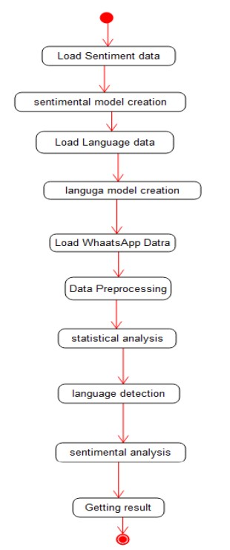
2. Block Diagram of proposed system

Slide 7
3. Feature extraction from dataset in the model
The main dataset which is taken by the user for WhatsApp chat analysis should be real time and it should be taken from the WhatsApp with export chat feature by the system user
For our project experiment we are using Kaggle WhatsApp Chat Data as input. WhatsApp data like time, user and message is collected and formed as a dataframe.
Source: https://www.kaggle.com/datasets/sarthaknautiyal/whatsappsample
2. Language Detection model and Sentiment Analysis model can be prepared using the naive bayes classification algorithm but for this we required messages labeled with proper language. In sentiment analysis dataset the texts are properly labeled as human emotion. Feature extraction done using Naïve-bayes classification.
Source: https://www.kaggle.com/datasets/basilb2s/language-detection
Source: https://www.kaggle.com/datasets/bhu1111/emotion-detection

Slide 8
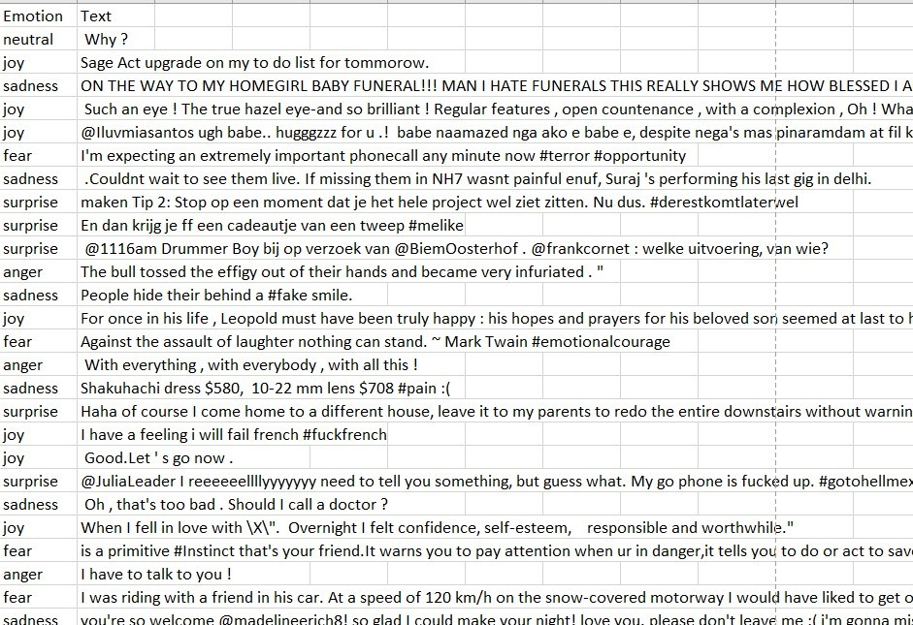
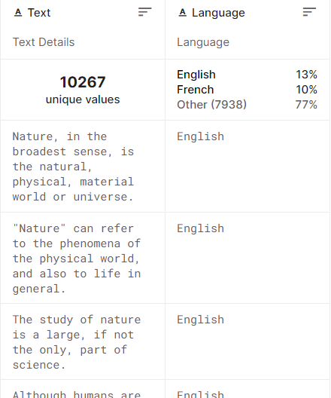
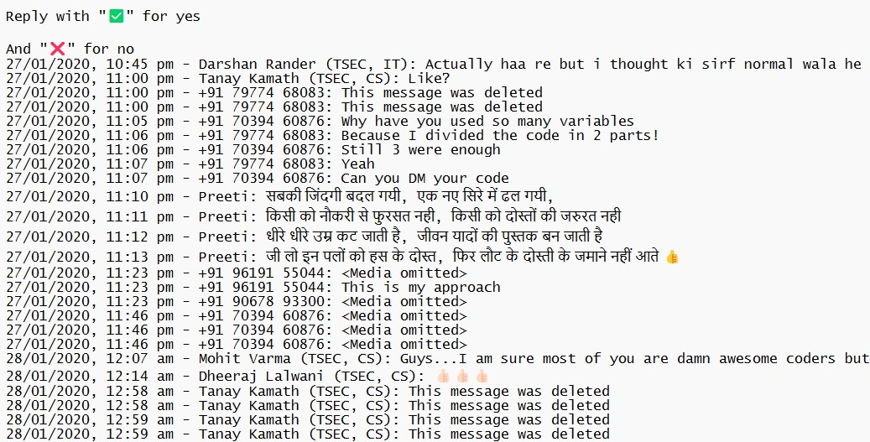
Language detection dataset
Sentiment analysis dataset
WhatsApp Dataset

Slide 9
MODULES
Data preprocessing module: Containing all the functionalities to form proper dataframes from WhatsApp dataset.
Helper module: Containing functions to solve the user query like fetch statistics, most common words, emojis, users, language detection and sentiment detection user defined functions.
Language Detection model Creator: used to create language detection model and export it for future use
Sentiment Detection model Creator: used to create sentiment detection model and export it for future use
App interface module: for user interface creation.

Slide 10
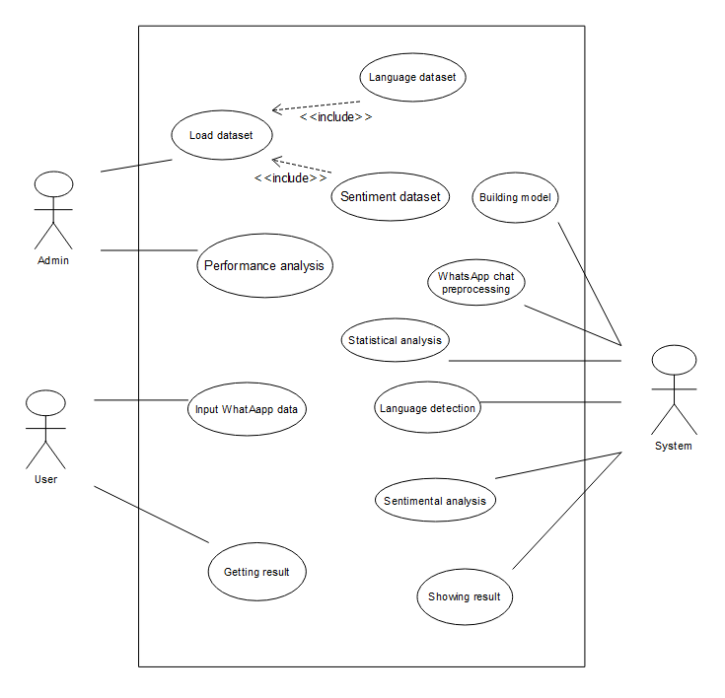
SYSTEM DESIGN:
Admin actor is administrator of the system who collects the datasets and upload to the system for creating all kind of models for sentiment analysis and language detection.
User actor refers to the end user who need some analysis from the application, so he/she decides to feed the system with proper format
System is another actor which is doing all kind of internal working for the chat analysis applying algorithm and build in methods and giving the outputs. Each actors have some use cases relevant to the projects. Those use cases are as followed.
Use case diagram

Slide 11
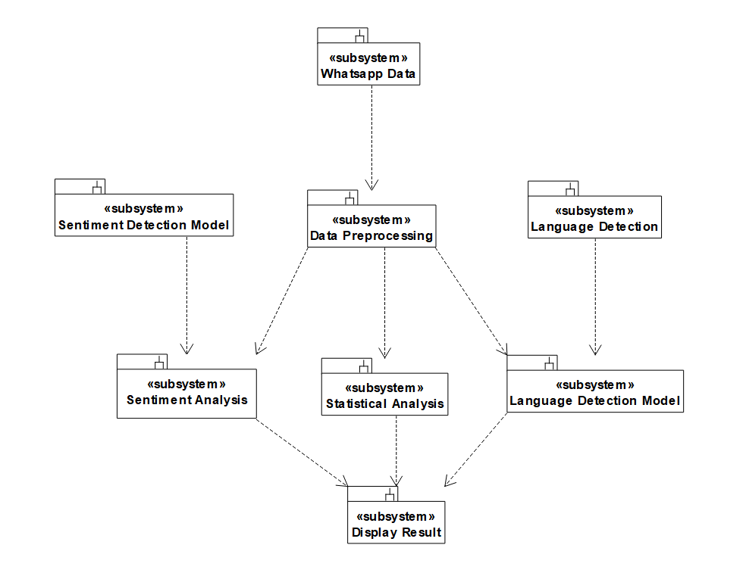
SUBSYSTEMS
Here our project has mainly three purposes which are Chat statistical analysis, Sentimental Analysis and Language detection. So, the three subsystems here are Statistical Analyze, Sentiment Analyze and Language Detection. For sentiment analyze mainly we are using vectorization. We are getting all kind of output a report with all kind of analysis results and visualizations graphs. A pictorial representation of subsystems as followed.

Slide 12
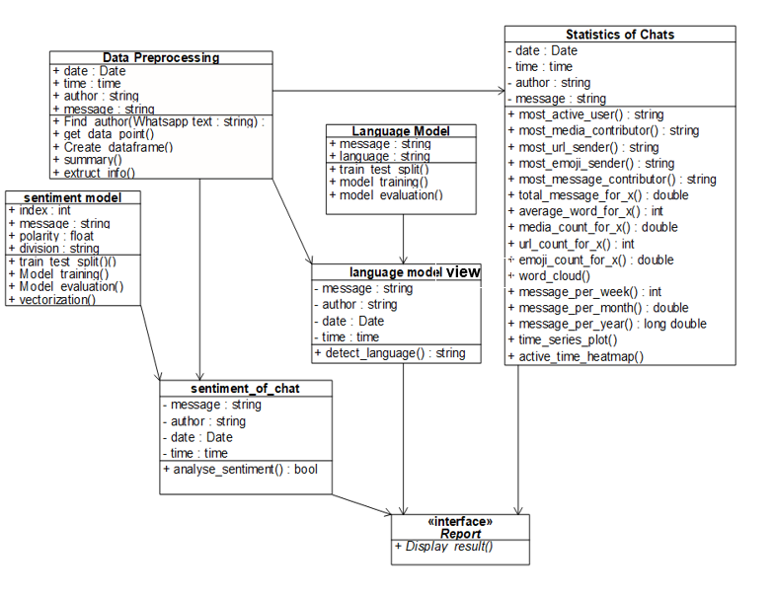
DIAGRAMS
Data Preprocessing :- To preprocess WhatsApp Data
Statistics Of Chats:- To analyze data statistically
Language Model:- To create language detection model
Sentiment Model:- To create sentiment analysis model
Sentiment Of Chat & Language model view to get result
Interface Report to see result
Class Diagram

Slide 13
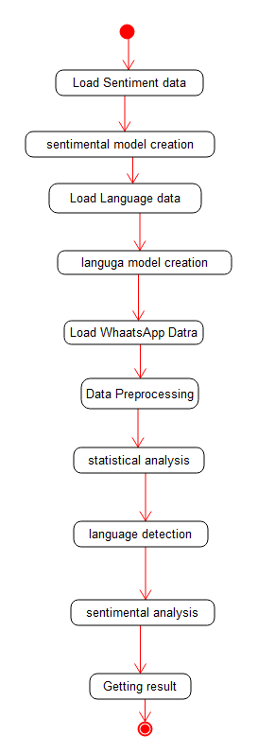
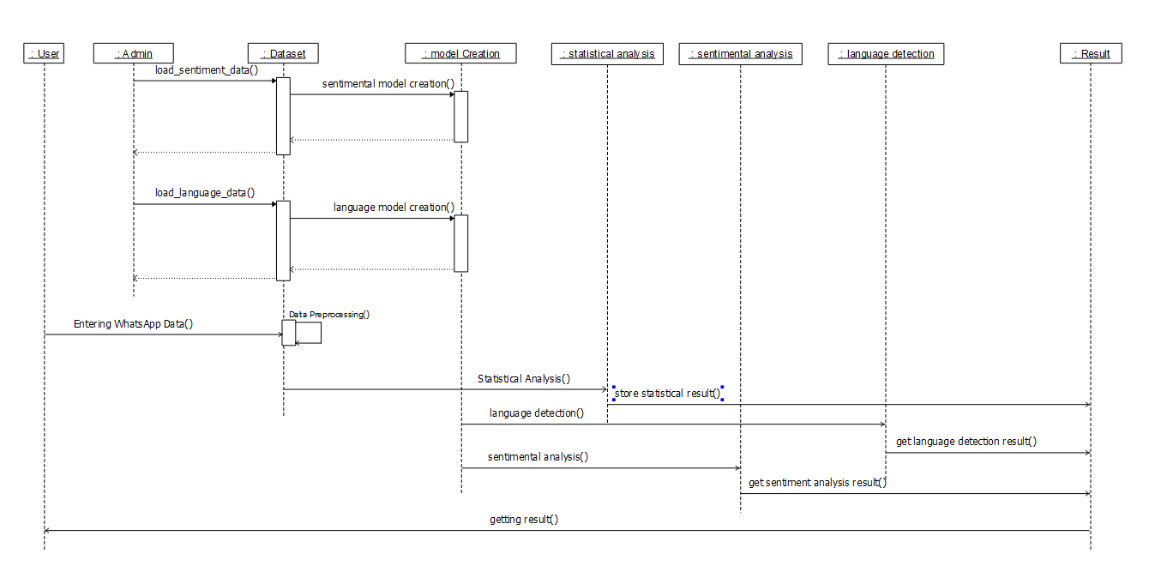
DIAGRAMS
Sequence Diagram
Activity Diagram

Slide 14
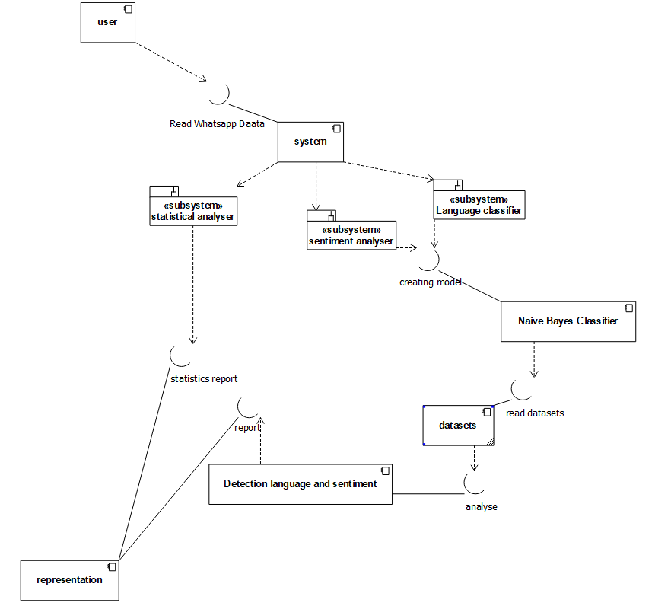
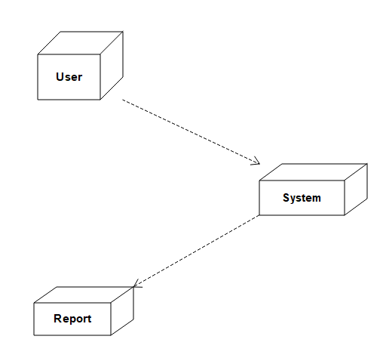
DIAGRAMS
Deployment Diagram
Component Diagram

Slide 15
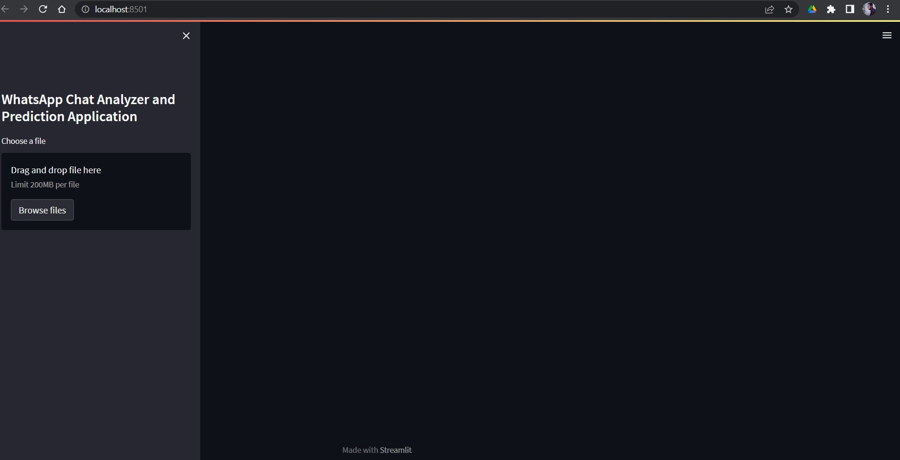
User Interface Screen Design

Slide 16
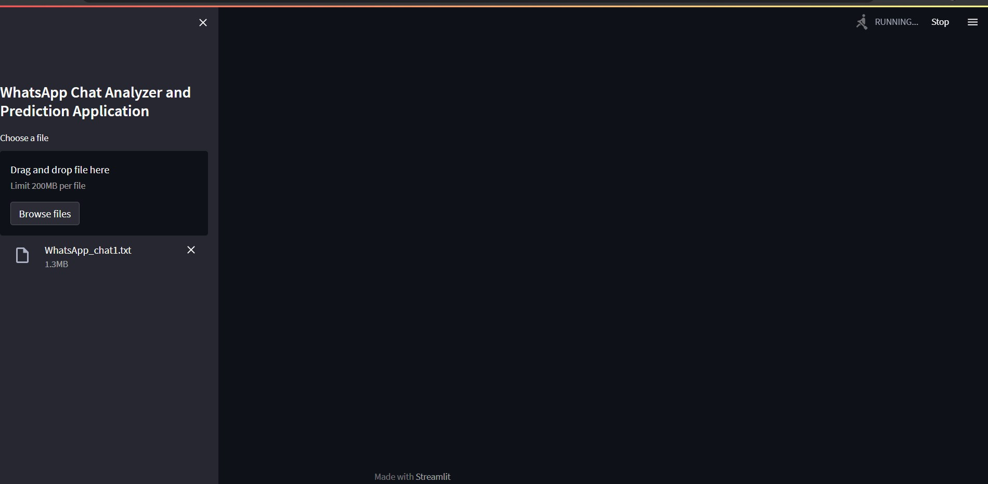

Slide 17
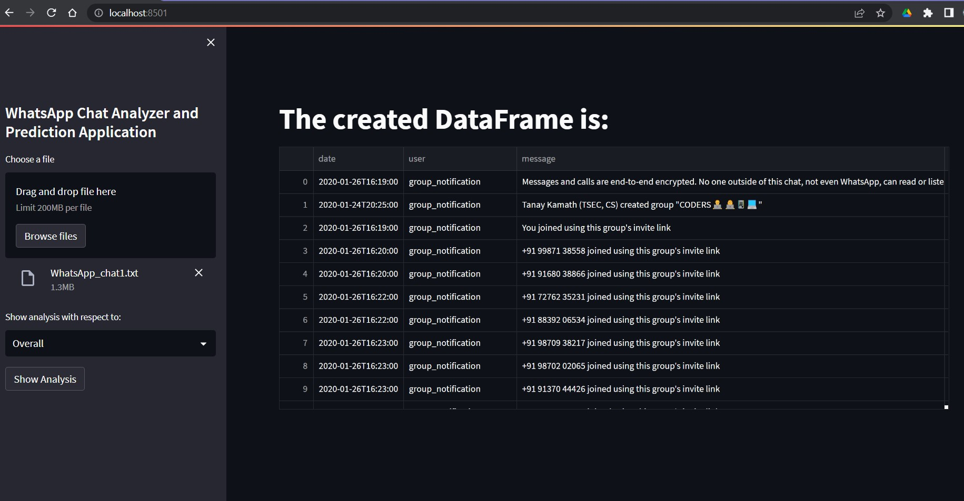

Slide 18
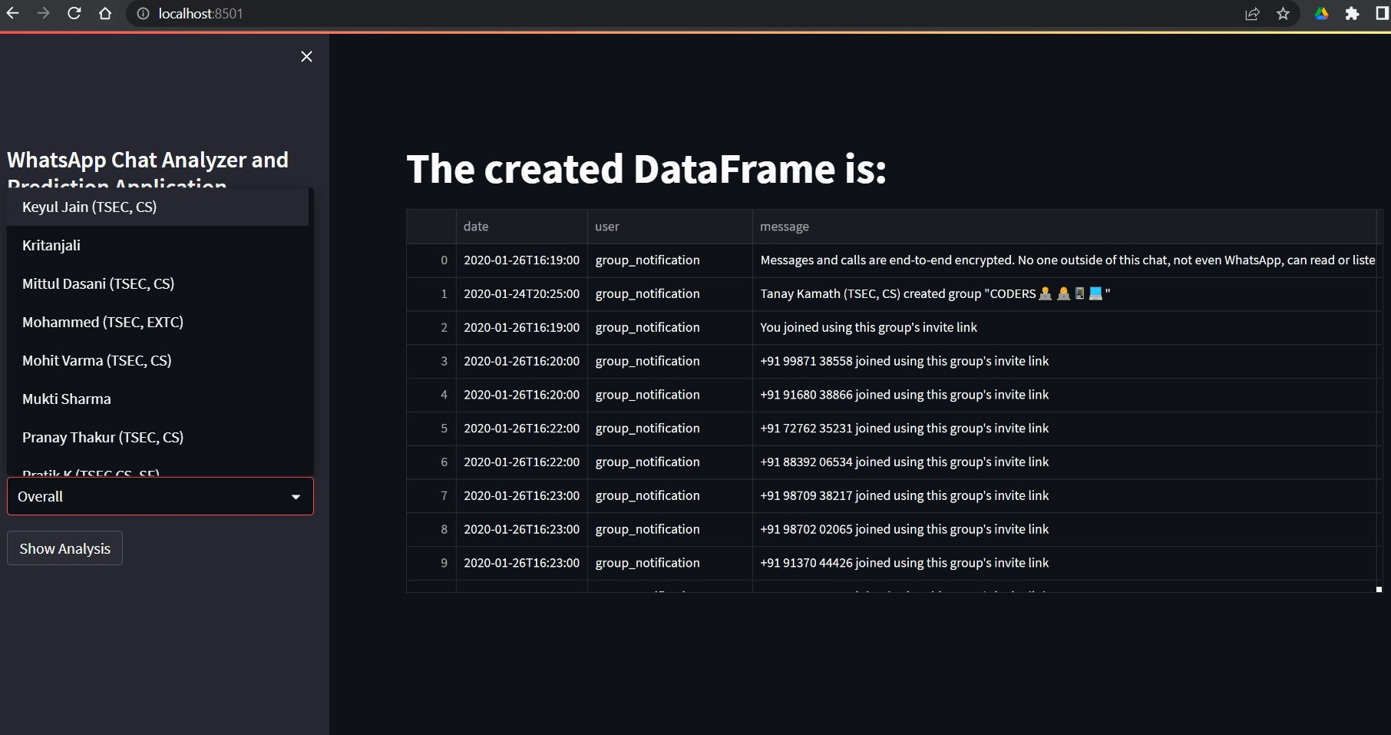

Slide 19
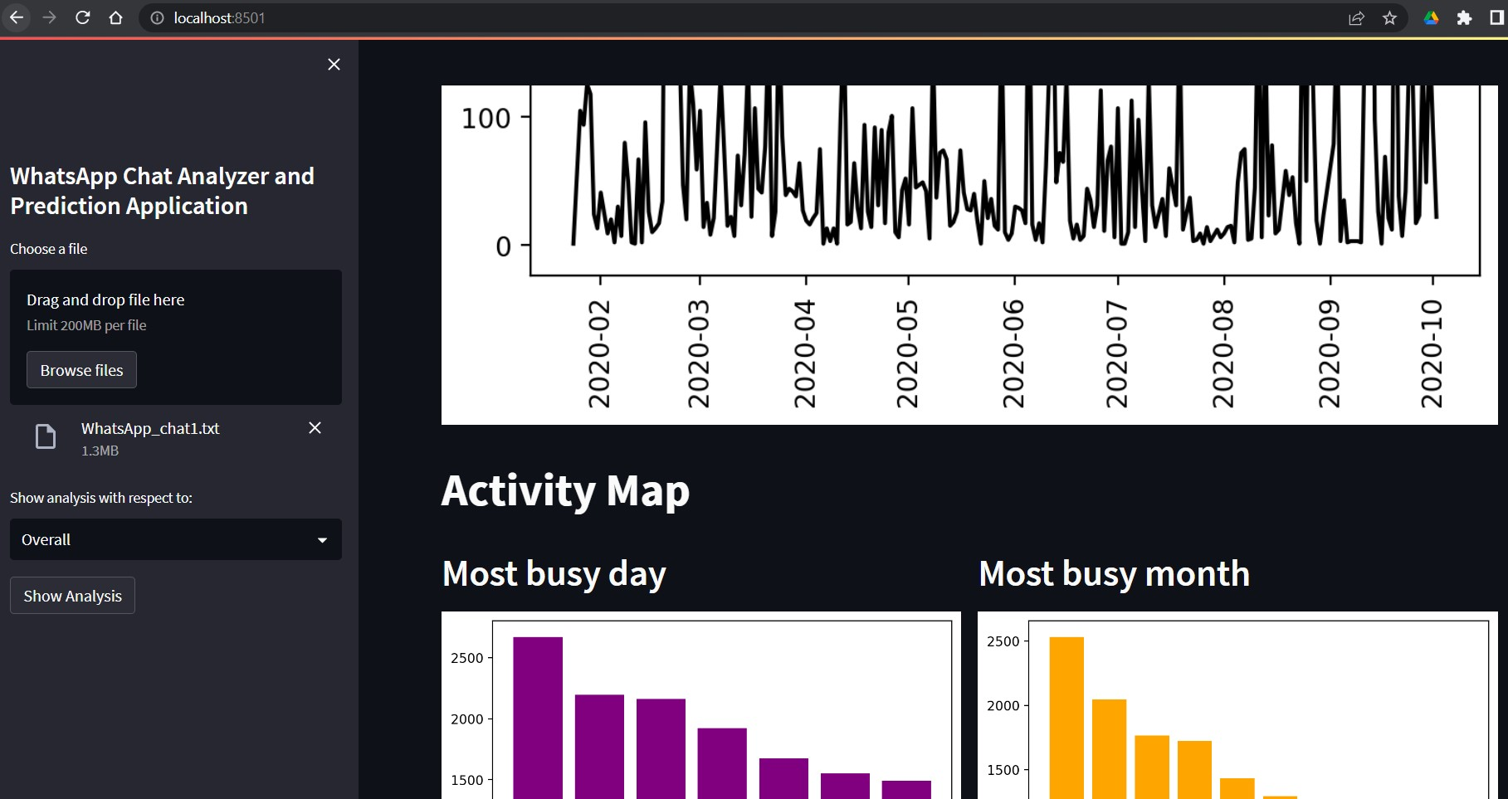

Slide 20
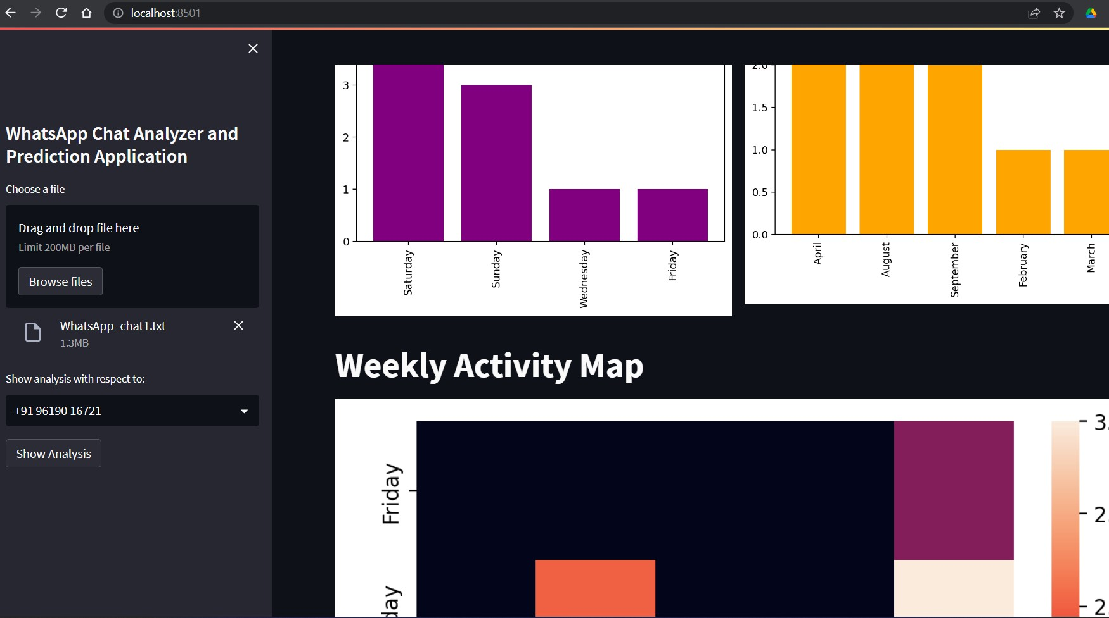

Slide 21
ADVANTAGES:
No particular application with all kind of mentioned feature.
No need to directly connect with WhatsApp so no risks of manipulating end-to-end encryption technique.
Models should be in local system, not at all connected to internet for file transfer and privacy terms preserved.
Can be very useful for individual uses as we have seen sentiment analyzer for enterprise uses only.
Databases not required

Slide 22
CONCLUSION
In conclusion about our project, we can express that, there is not an existing system available with WhatsApp data sentiment analysis for end users. Conflicts in WhatsApp group conversations may create more social problems. Peoples are using delivering hate speeches and fake information to create panic in society through WhatsApp. People can use WhatsApp freely in developing countries so more security concerns is to be present for our society regarding this app. The used algorithms in the proposed system are very easy to implement and no need to have large infrastructures to implement this. We have implemented same Naïve bayes classification algorithm for creating both the models. Further any user can get a nice interaction with system with user friendly interfaces. After successful implementation of the system, it will help a large number of group admins who have so much daily work with WhatsApp chats. In future we can add other advanced features to the system as well. We hope this will solve the existing problems in certain extend and will express the power of artificial intelligence in society.

Slide 23
BIBLIOGRAPHY
[1] Dahiya, S., Mohta, A., & Jain, A. (2020, June). Text classification based behavioural analysis of whatsapp chats. In 2020 5th international conference on communication and electronics systems (ICCES) (pp. 717-724). IEEE.
[2] Mohta, A., Jain, A., Saluja, A., & Dahiya, S. (2020, October). Pre-Processing and Emoji Classification of WhatsApp Chats for Sentiment Analysis. In 2020 Fourth International Conference on I-SMAC (IoT in Social, Mobile, Analytics and Cloud)(I-SMAC) (pp. 514-519). IEEE.
[3] Kanakia, H., Raundale, P., Britto, R., & Sawardekar, R. (2019, May). Analysis of Social Networks using Naive Bayes. In 2019 International Conference on Intelligent Computing and Control Systems (ICCS) (pp. 88-91). IEEE.
[4] Shafiq, M., Yu, X., & Laghari, A. A. (2016, September). WeChat text messages service flow traffic classification using machine learning technique. In 2016 6th International Conference on IT Convergence and Security (ICITCS) (pp. 1-5). IEEE.
[5] Liu, B., Blasch, E., Chen, Y., Shen, D., & Chen, G. (2013, October). Scalable sentiment classification for big data analysis using naive bayes classifier. In 2013 IEEE international conference on big data (pp. 99-104). IEEE.

Slide 24
Thank You

